Slide 1

The Multichain World is Centralized :(
⚡🤖
Alex Obadia (Flashbots) - MEV Day, 22/04/2022

Slide 2
What’s the ‘multichain’ world? 🌏
⚡🤖
🏗 Many domains: L1s, L2s, bridges, side-chains
👯 Same apps redeployed everywhere
🍎🍊 different security
more: https://vitalik.ca/general/2021/12/06/endgame.html, https://www.diffchecker.com/qJpDSkY0, https://blog.celestia.org/clusters/
Notes:
layer 2s, layer 1s, app specific chains, bridges to go between them that are also their own domains. Maybe split in clusters (or trust-minimized zones)
One where the same apps are deployed on each chains. For example Uniswap is deployed on many chains

Slide 3
Immediately - fragmentation 💔
⚡🤖
of liquidity across pools on different domains
of security assumptions across different bridges
of different assets representations for base assets
…
⇒ new source of inefficiencies from lack of standards and nascent markets where winning designs are still emerging
⇒ MEV!
Notes:
add to that new cross-chain interactions, governance, cross-collateralization and whatnot

Slide 4

Let’s arb it
⚡🤖
Start with DAI
on Ethereum
ETH/DAI 400
on Optimism
💸
ETH/DAI 300
on Arbitrum
💰
Try #1: takes 2 weeks + 10mins 🥵
Try #2: we use non-native bridges, it’s now reduced to ~25mins, mmkay
Try #3: we don’t even bridge, we just have capital on each, now a few seconds

Slide 5
Hints on market structure
⚡🤖
Capital requirements
Inventory management
Re-introduction of legging risks

Slide 6
Extending this logic
⚡🤖
We have an asynchronous world where the most well-capitalized are the fastest and where others rely on short-term lenders (bridges) in order to move fast between domains
⇒ amplifies wealth inequality (some opportunities only accessible to the most well capitalized)
⇒ a more centralized and trusted infrastructure :(

Slide 7
This isn’t great..but wait
there’s more!

Slide 8

Cross-domain collusion
⚡🤖
Take 2 domains, a and b, and evaluate whether mev(a+b) > mev(a) + mev(b)
If yes, then there’s a non zero financial incentive for sequencers to collude.
more: https://arxiv.org/abs/2112.01472
A
B
A
B

Slide 9
🤔
⚡🤖
Can your nice protocol designed in a vacuum be subject to incentives beyond itself that will influence eg. validator behaviours, eg. centralisation of the validator set, eg. who will participate in validation?

Slide 10
But wait!
⚡🤖
there’s more..
how do they trust each other? How do they share information? How do they split MEV? There’s an economic cost to all of that
🤨
🤨
?
A
B

Slide 11
The cost
Impossibility result: cross ledger communication cannot happen without either a trusted third party or a synchrony assumption beyond asynchrony
And because I claim latency assumptions are not great here, there’s a trust assumption involved which is a cost
SoK: Communication Across Distributed Ledgers https://eprint.iacr.org/2019/1128.pdf

Slide 12
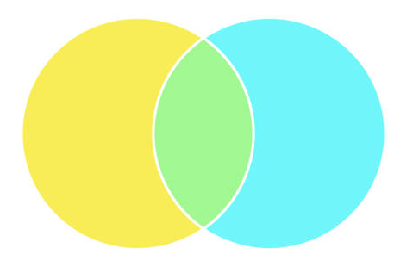
One way to reduce the coordination/communication cost
⚡🤖
is to just own the validators everywhere
😈

Slide 13
so.. the multichain world is… centralized? :(
⚡🤖
not yet
it’s coming though, the incentives are currently set this way

Slide 14

wat do?
⚡🤖
cancel multichain? well, no
we need it for scaling..

Slide 15
#1: awareness
Domain designers, validators companies running on many networks, users, should all pay attention.
Before a real technological solution emerges, this very centralized world might be avoided by social norms.

Slide 16
#2: moar research
⚡🤖
Cross-chain MEV-motivated reorgs
Domain standardisation of assets & of bridges, norms of using trustless bridges
How far can we reduce communication/coordination cost for cross-domain collusion?
Other qs in the paper
Work with us!

Slide 17
Questions?
read the WIP paper: https://arxiv.org/abs/2112.01472 for more
& reach out: alex@flashbots.net or Twitter @ObadiaAlex
⚡🤖

Slide 18
Appendix

Slide 19
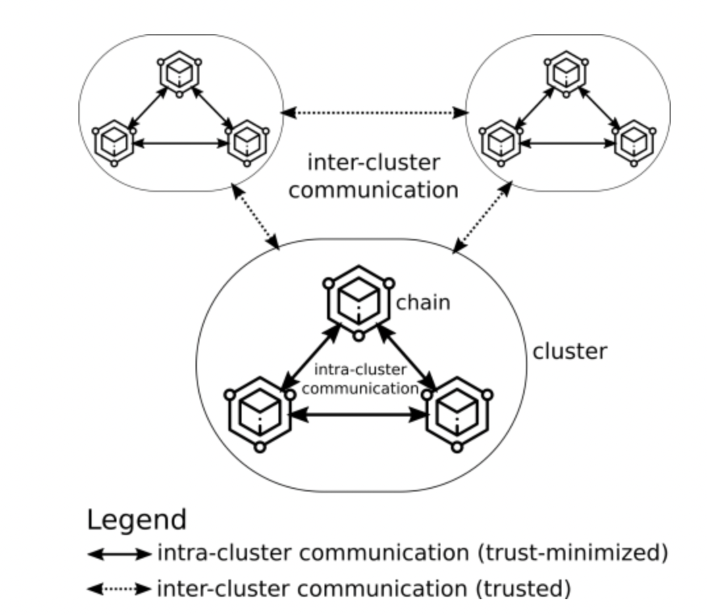

Slide 20
